Slide 1
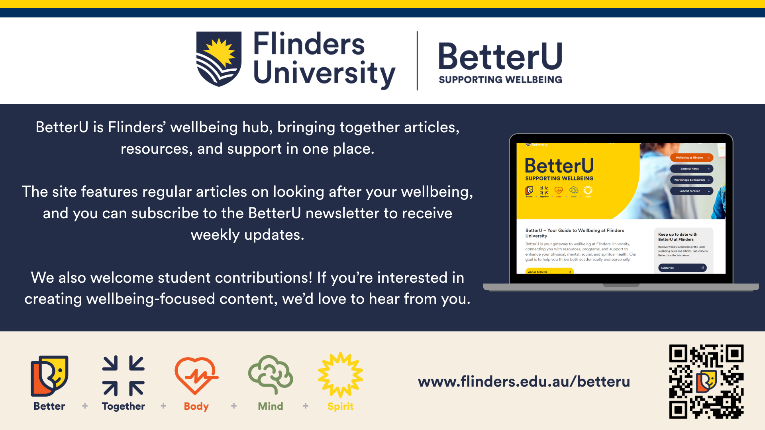
Notes:
Before we jump into today’s content, I want to point you toward BetterU. It’s the central wellbeing hub for all of us here at Flinders.
Think of it as your 'one-stop-shop' for student life. It’s full of practical guides on things like managing procrastination or stress, but it also acts as a bridge to professional supports - linking you directly to Health, Counselling and Disability Services (HCDS), the Oasis Student Wellbeing Centre, and programs like the Good Vibes Experiment.
Your best first step is to scan the QR code on the slide or type in the URL to visit the site and subscribe. You’ll get a weekly update with wellbeing advice and info on programs running throughout the year so you don't have to go looking for them when you're busy. While you're at it, keep an eye out for the BetterU team at campus events like Wellbeing Week. They're often out and about to chat in person.
Finally, as you can see on the slide, BetterU is actually co-designed by students. If you’re interested in becoming a content creator yourself, they are always looking for new voices to join the newsroom team.
It’s a great resource to have in your back pocket, so definitely check it out.

